Slide 1
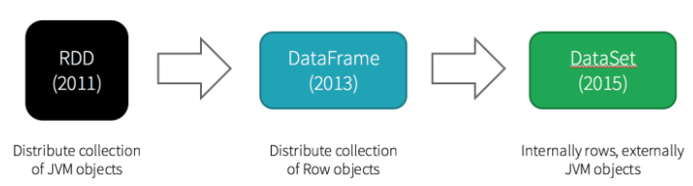

Slide 2
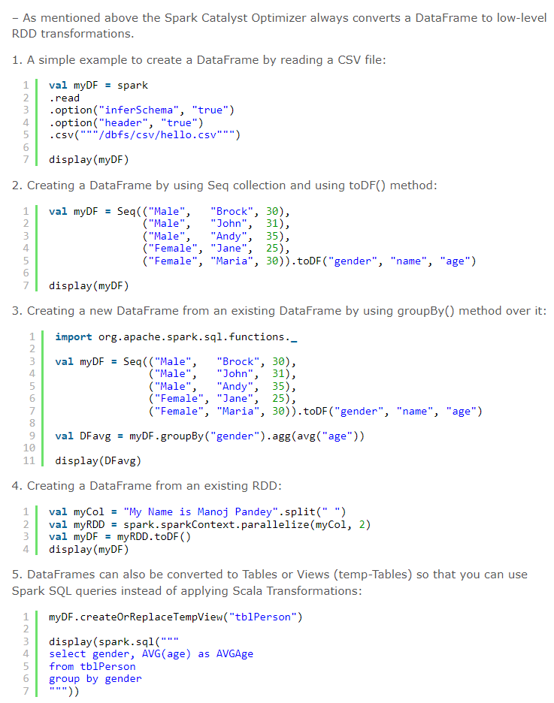

Slide 3
What is the difference between Data frame and Dataset?

Slide 4
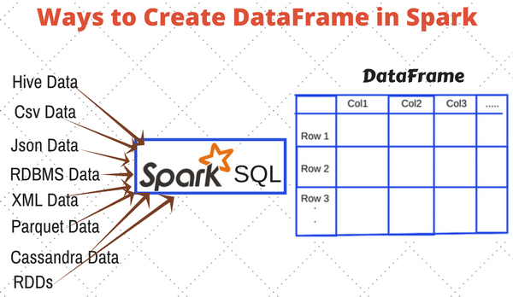
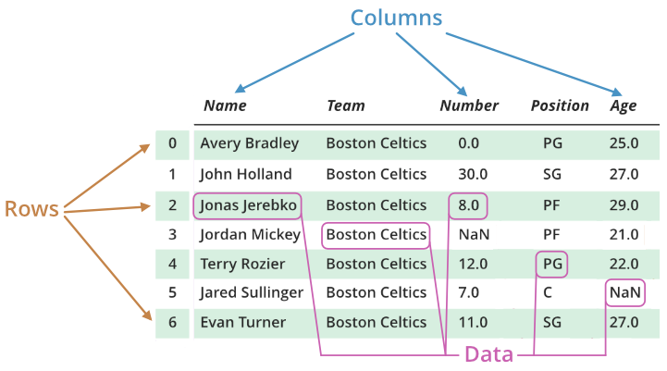

Slide 5
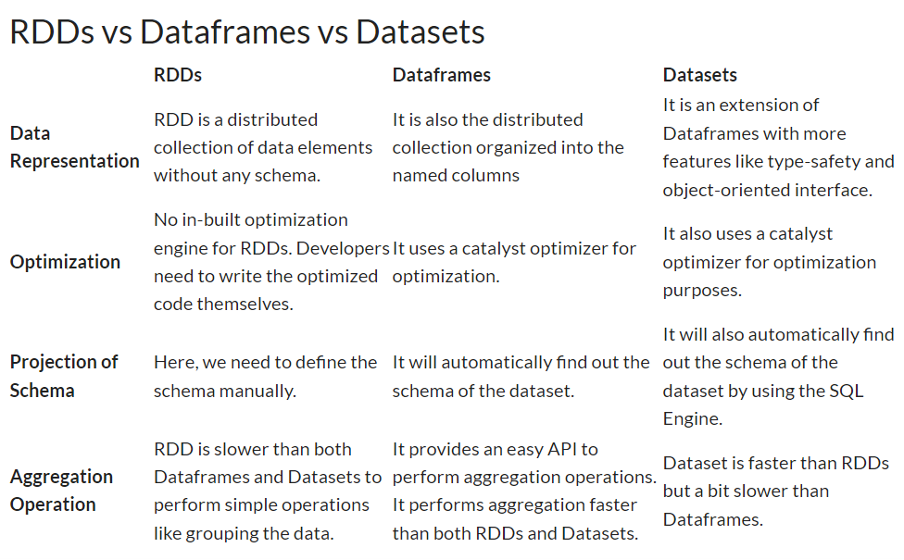

Slide 6
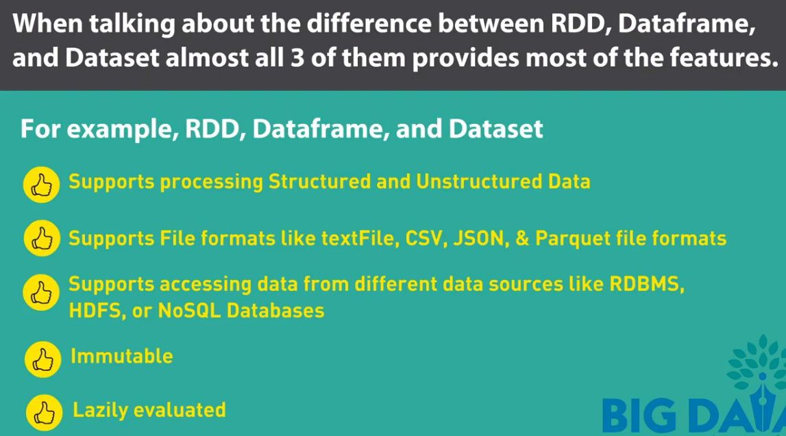
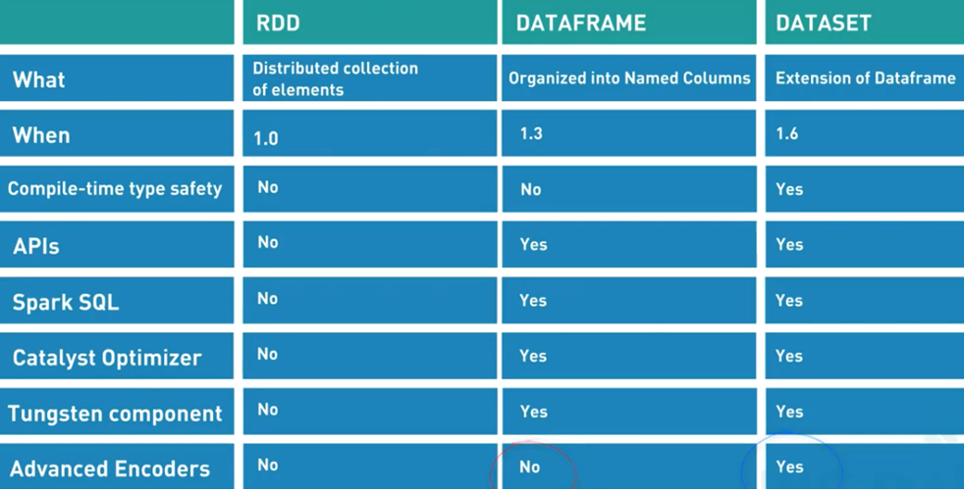

Slide 7
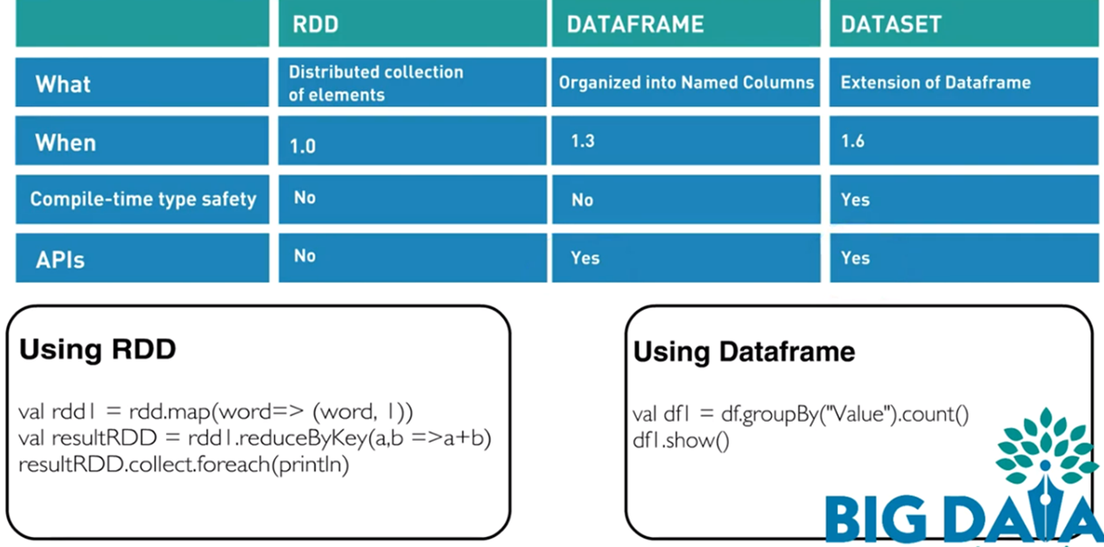


Slide 8
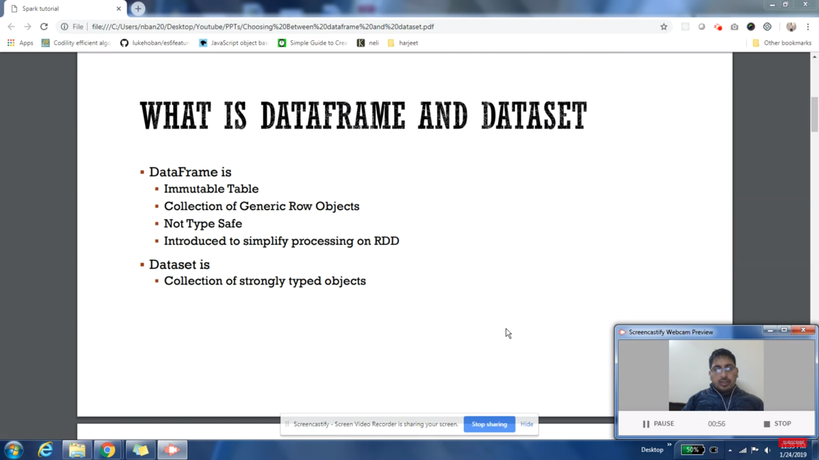
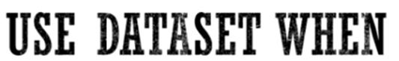
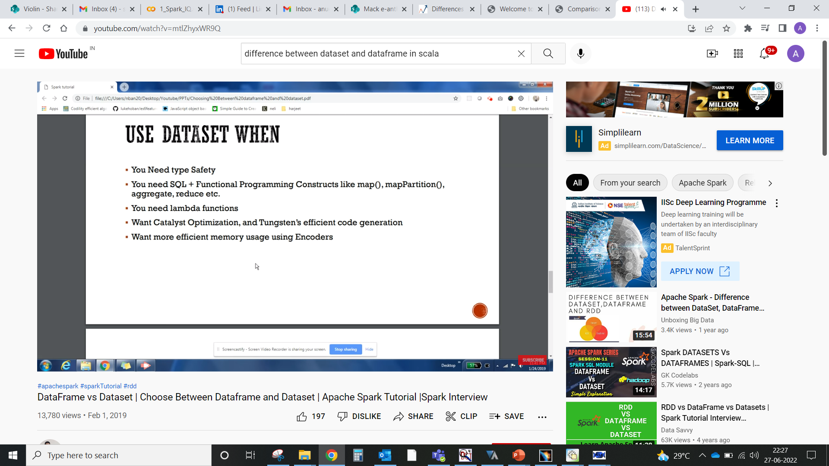
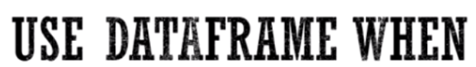
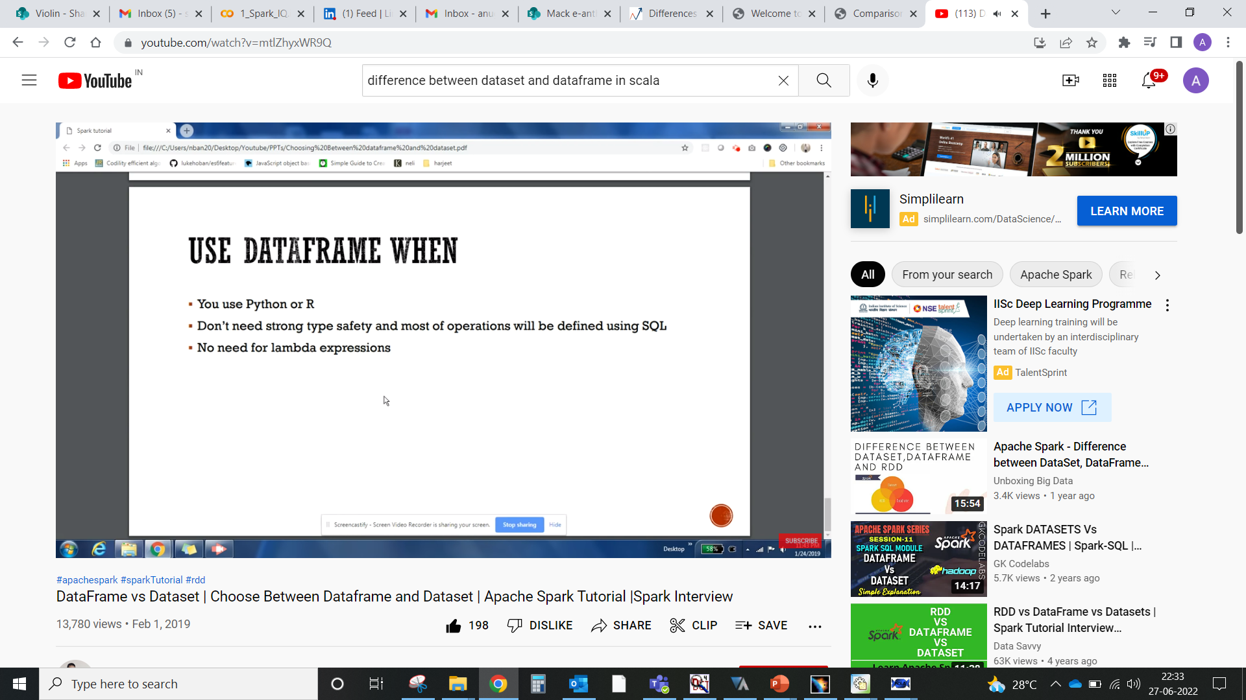

Slide 9
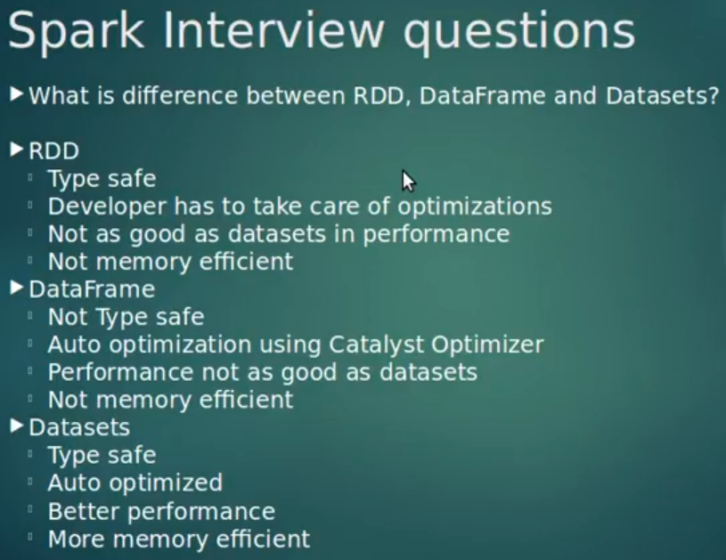

Slide 10
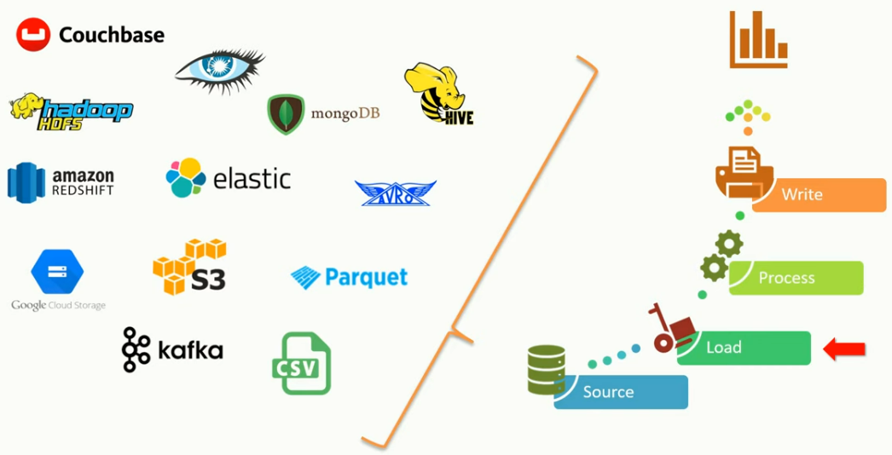

Slide 11
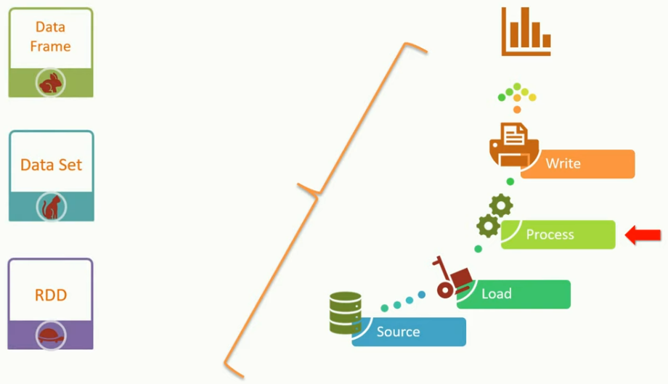

Slide 12
RDD

Slide 14
Data Frame

Slide 15
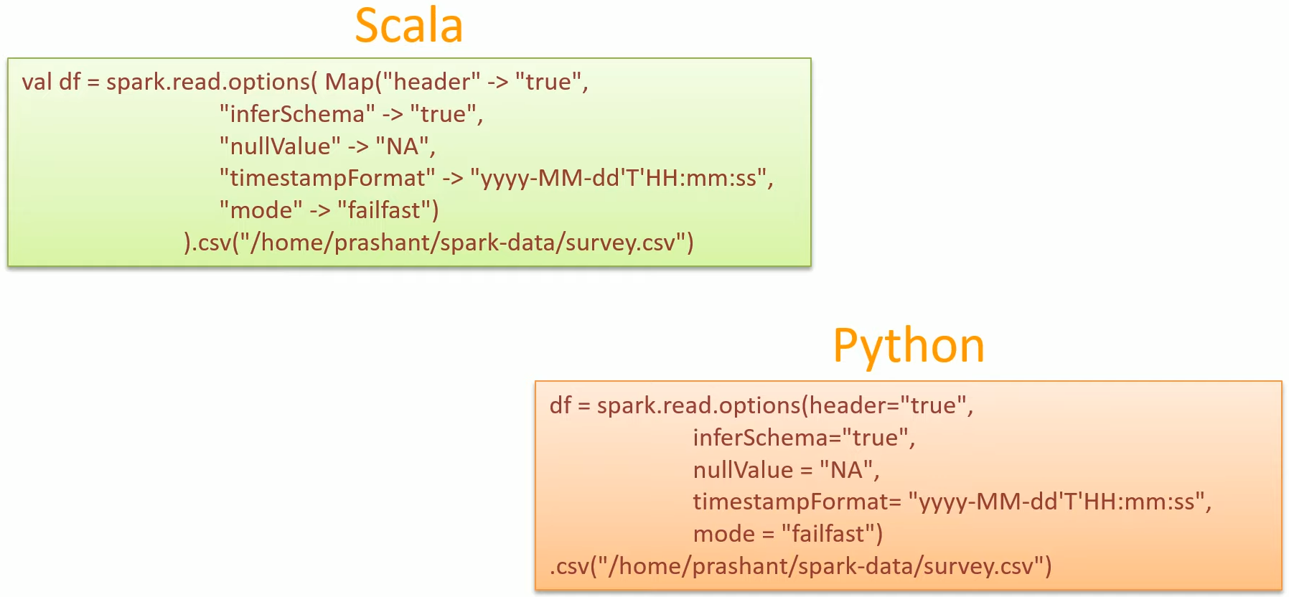

Slide 16
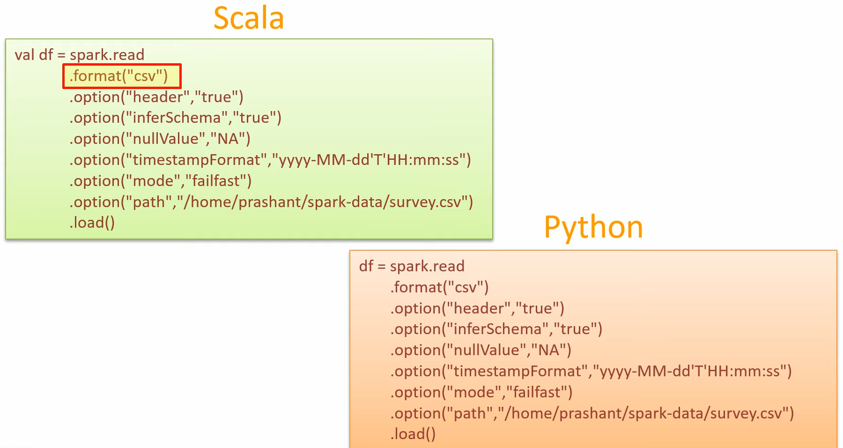

Slide 17
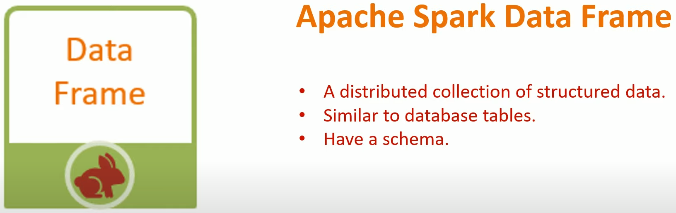
Data is organized into named columns, like a table in a relational database
A data frame is nothing but an abstraction on top of RDD
Data Frame have schema
Data Frames are immutable
Spark Datasets/Data Frames are distributed

Slide 18
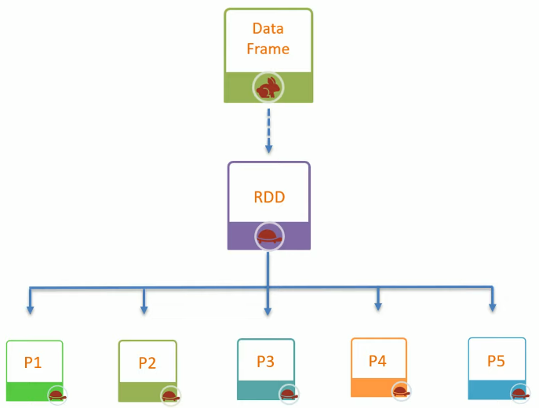
Abstraction
A data frame is nothing but an abstraction on top of RDD. Since an RDD is broken down into partitions, and Data Frame is just an abstraction over RDD. Hence a data frame is also partitioned.

Slide 19
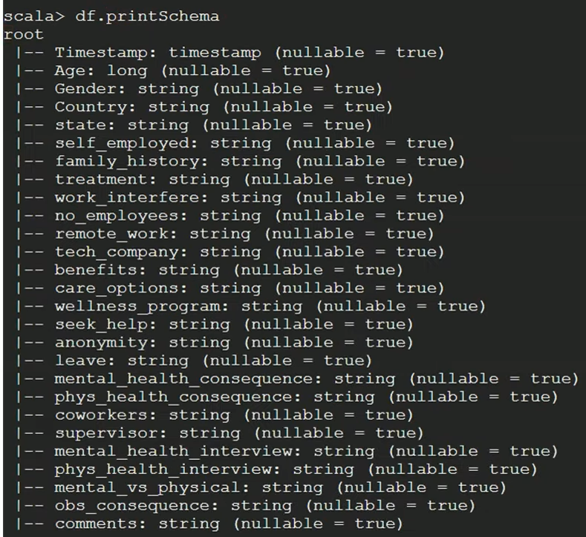
Schema

Slide 20
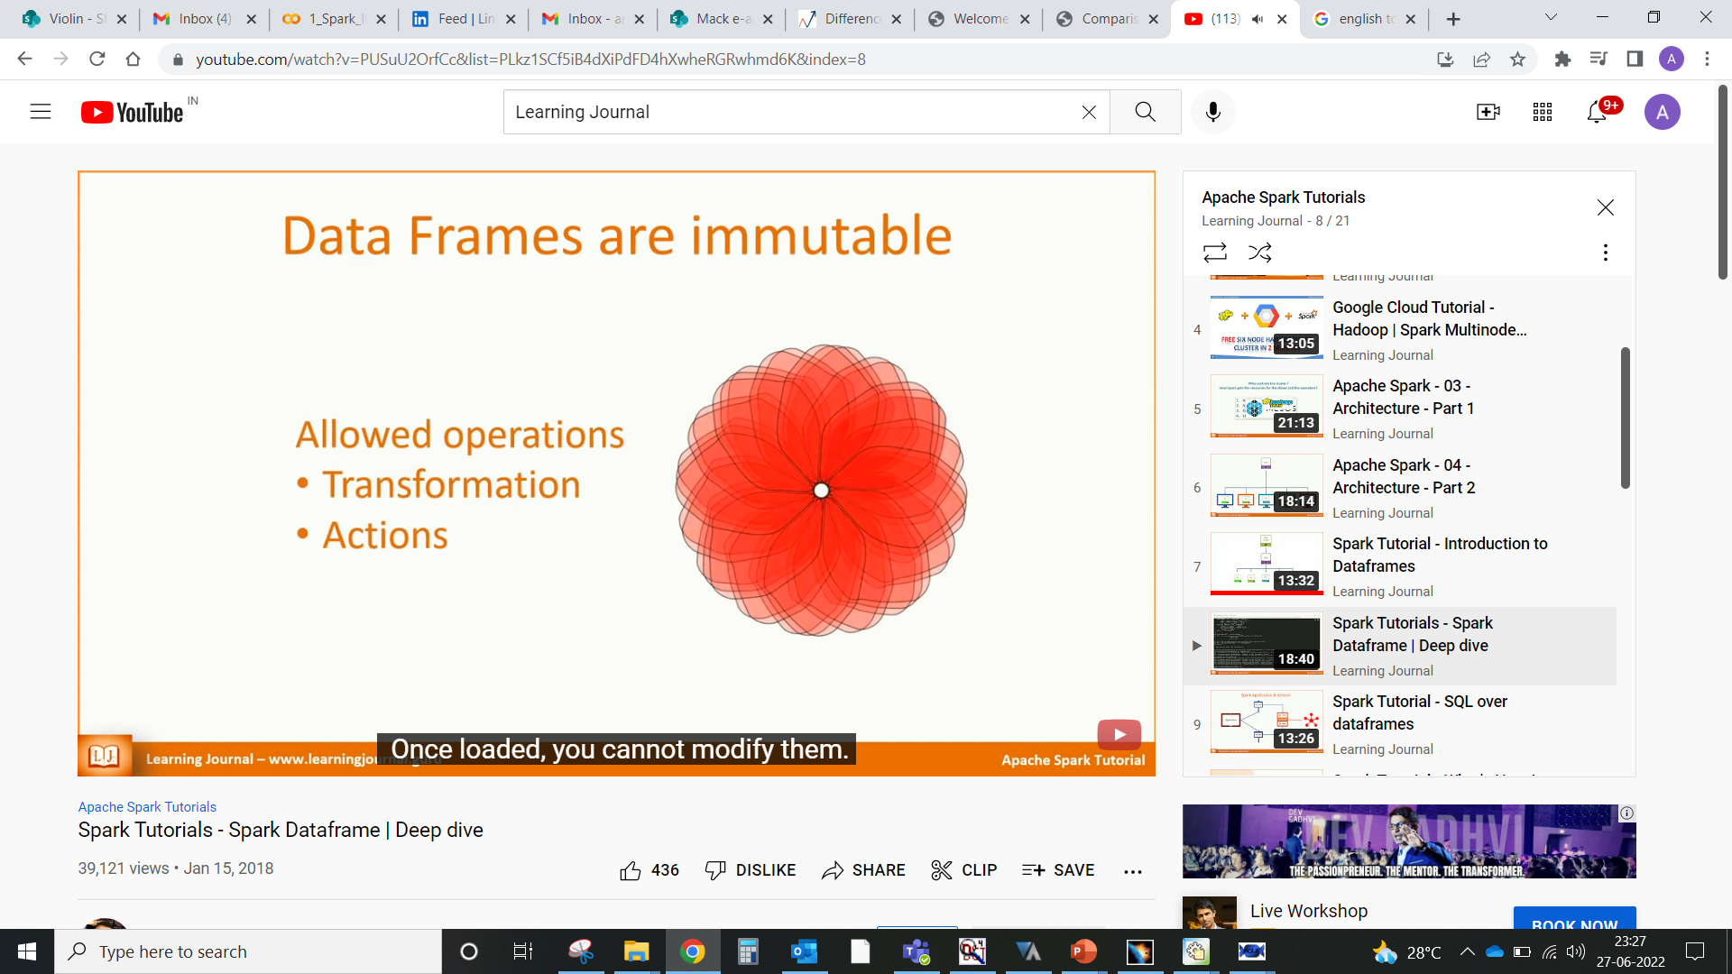
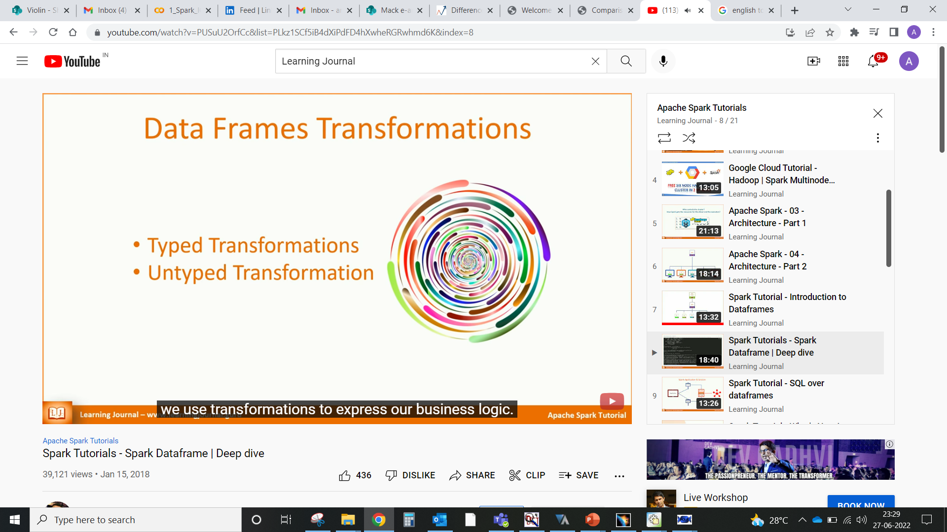
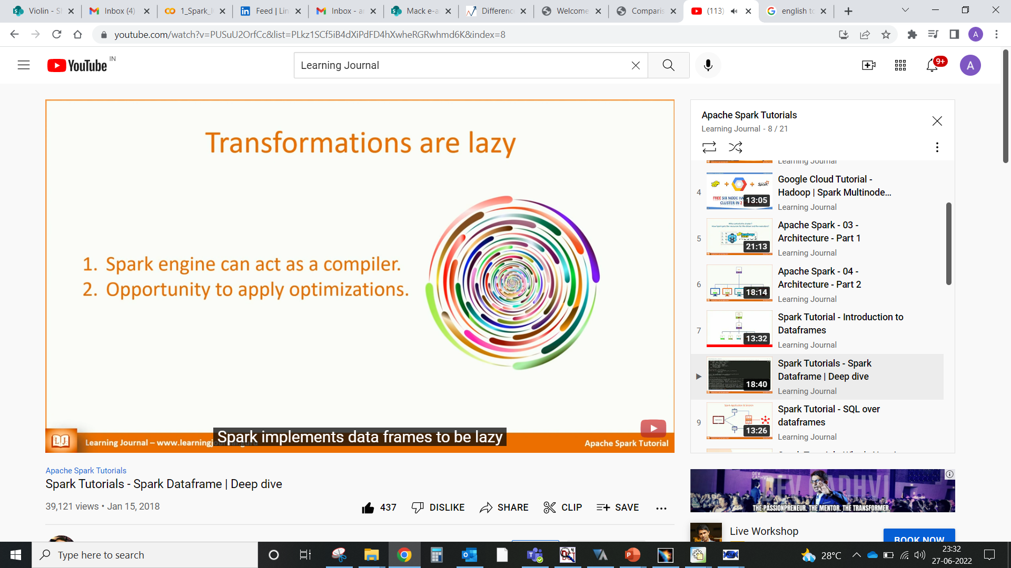
immutable
Spark has two types of operations:
a) transformations
b) actions
Transformations:
are operations that transform a Spark Data Frame (or Dataset) into a new Data Frame. (Of course, they don’t really change the original Data Frame since they are immutable. Instead, they return a new transformed Data Frame.)
In Spark, transformations are computed lazily, so the execution of transformations is delayed until an action is invoked.
Actions:
- are any other operations that do not return a Data Frame or Dataset. For example, they can display a Data Frame on the screen, write it to storage, or trigger a computation on that and return the result (like counting the number of rows in a Data Frame).

Slide 21
Spark Datasets / Data Frames are distributed:
Pandas runs on a single machine, but Spark code can be executed in a distributed way, so Spark Datasets/Data Frames are distributed in nature.

Slide 22
Data Set

Slide 24
What is the difference between RDD and data frame ?

Slide 25
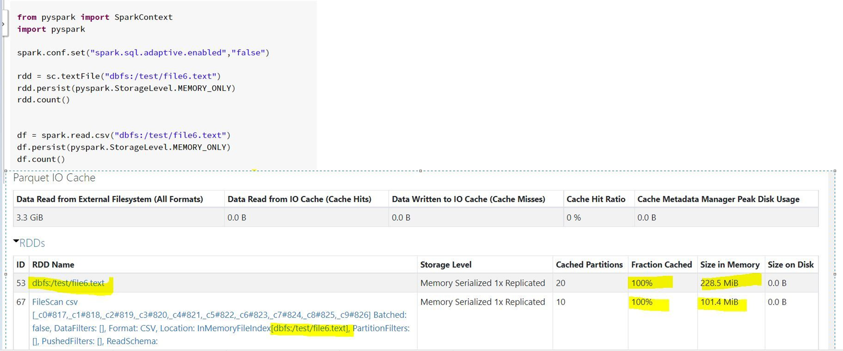

Slide 26
